Slide 1
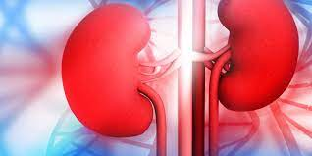
Prediction of Kidney Chronic Disease
Presented by:
Sony Sinha
MBA IT 2ND Year
PIMSE

Slide 2
Problem Statement
Chronic kidney disease (CKD) is non-communicable disease that has significantly contributed to morbidity and mortality of patients worldwide.
Its burden is even higher in low-income countries where detection, prevention and treatment remain low.
To Build a Machine Learning Model to predict whether a person is suffering from Kidney Chronic Disease or not.

Slide 3
Scope of Project
The machine learning predicted model can be used in hospitals and clinics by doctors and nurses to predict if the patient is suffering from the chronic kidney disease based on their pathological attributes.
The main purpose of building the machine learning model is to predict renal disease by analyzing pathological data by applying machine learning classification approaches to predict the disease using the model with highest accuracy for detecting chronic kidney disease in its early stages to opt for dialysis and renal transplantation.

Slide 4
Dataset Source And Methodology
Data Source:
The data is gathered for two months from patients at a hospital in Karaikudi, Tamil Nādu from Appolo Hospitals , available to public.
Life cycle of a Machine Learning project
# Understanding Problem Statement
# Data Collection
# Data Cleaning
# Exploratory Data Analysis
# Pre-processing of Data
# Model Training
# Picking the Best Model

Slide 5
Machine Learning Algorithms
1. LogisticRegression
2. Support Vector Classifier
3. DecisionTreeClassifier
4. Multinomial Naive Bayes
5. KNeighborsClassifier
6. Gradient Boosting machine Classifier

Slide 6
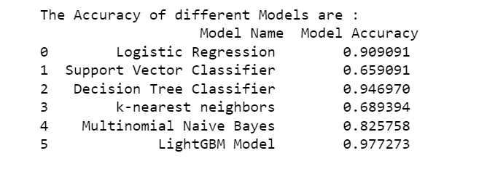

Comparison of Different ML Model Accuracy

Slide 7
Tools and Technology
Programming Language Used: Python
Libraries used : Pandas, Numpy, Seaborn, matplotlib, Sklearn, skimage, pandas_profiling
Editor Used for Development: Jupyter Notebook
Technology: Machine Learning
Database Used: MongoDB
Limitations
1. Prediction is not Exact
2. Error Prone
3. Different Models have different accuracy

Slide 8
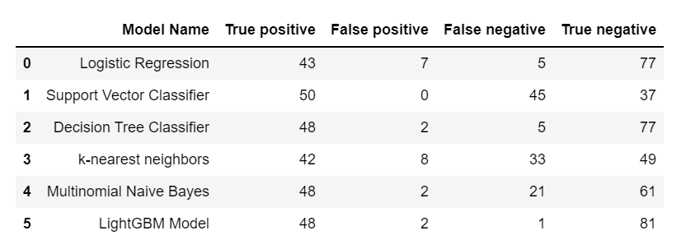
Performance Metrics of Model

Slide 9
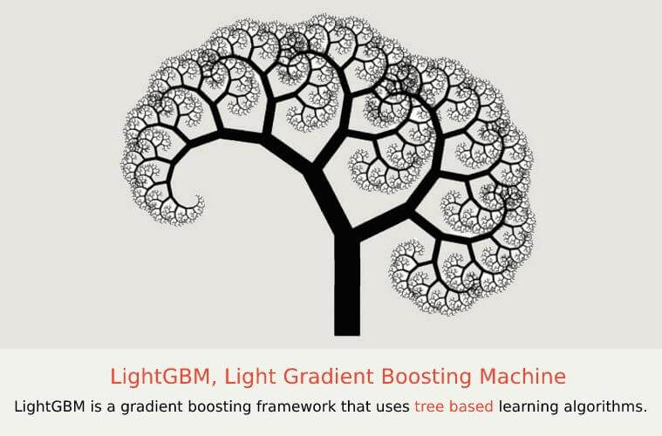
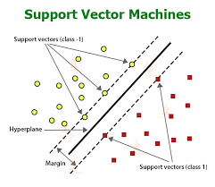
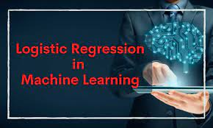
Conclusion
Prediction of Chronic Kidney Disease model is build using python programming language, machine learning algorithms and MongoDb(Pymongo).
LightGBM model gives a better accuracy to predict chronic kidney disease then the other models.

Slide 10


